Slide 1
Name: Swapnil Ghosh
Group: A2
Roll: 001911001067
TASK 14

Slide 2
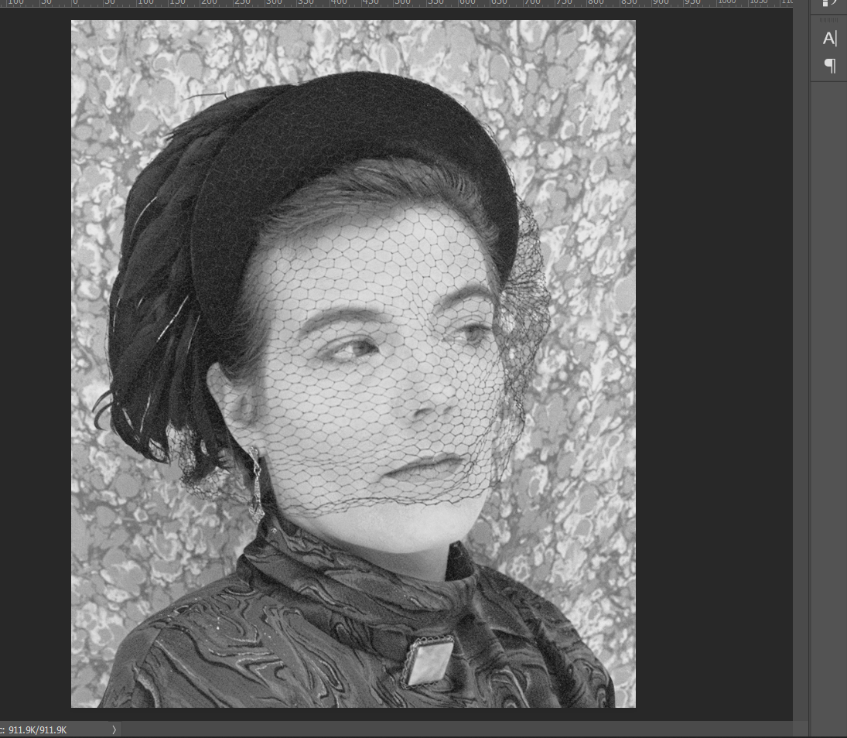
Colour to Grayscale
Step-1) Opened the file CAMEO.TIF in Photoshop.
Step-2) Converted the image to grayscale by choosing Image > Adjust > Desaturate.
Step-3) Undo the changes and use Image > Mode > LAB colour and choose the L channel and then grayscale the image

Slide 3
Grayscale to Colour
Step-1) Opened the file CAMEO.TIF in Photoshop.
Step-2) In Image > Mode > Indexed color choose the Adaptive palette setting.
Step-3) In Image > Mode > Color Table, ( This shows 256 colors derived from the image ).
Step-4) Clicked the Save button to save the color table as CAMEO.ACT, and loaded the color table in swatch palette.
Step-5) Opened the file CAMEO_GS.TIF in Photoshop.
Step-6) Choose Image > Mode > RGB Color and in Layer and created a new Layer as Color.
Step-7) Change blending mode of the new layer to Color and selected Paintbrush tool and 65-pixel soft brush to color it.

Slide 4
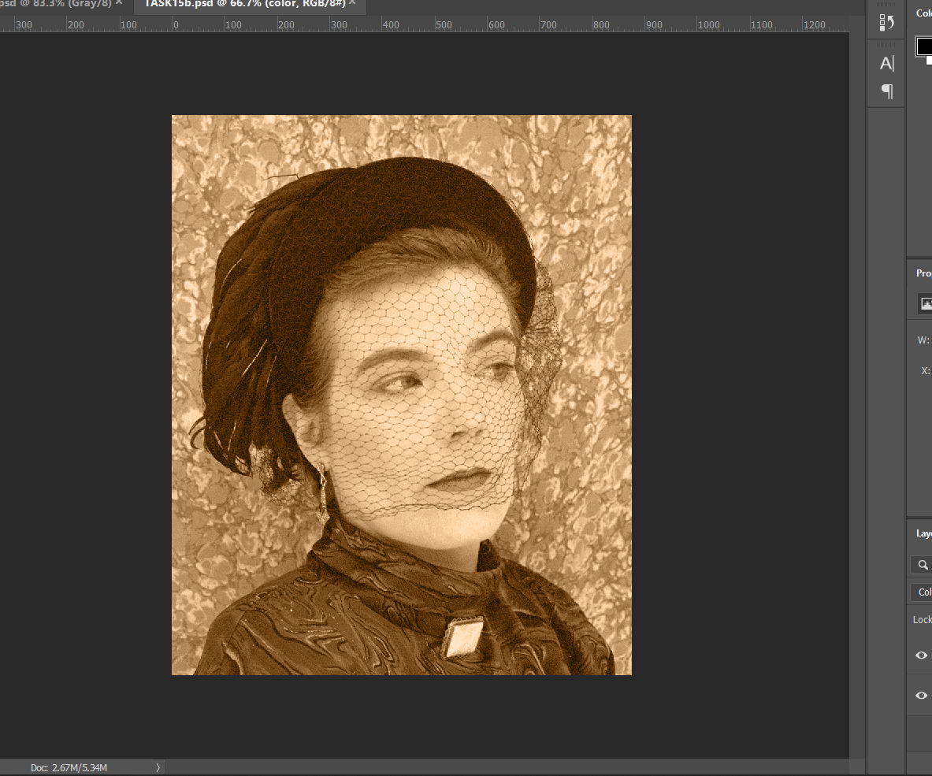
Grayscale to Duotone
Step-1) Opened the file CAMEO_GS.TIF in Photoshop.
Step-2) Choose Image > Mode > Duotone color.
Step-3) Click on color box for Ink2 and Choose Pantone Uncoated ink, # 126.
Step-4) For Ink1 (black) choose color distribution as 50: 30%. For Ink2 choose 50: 70%.

